Slide 1

Project Management TaskGo
Instructors Guide:
AP Huỳnh Công Pháp
Instructors guide
Associate Professor Ph.D Huỳnh Công Pháp
Member:
1. Phạm Hoàng Sang
2. Lê Văn Tường

Slide 2
Content
Introduction
Systems Analysis and Design
Website’s interface

Slide 3
1.
Introduction
What is Project Management?

Slide 4

Project Management
is the application of knowledge, skills, tools, and techniques to project activities to meet the project requirements

Slide 5
1.
Introduction
What is TaskGo?

Slide 6
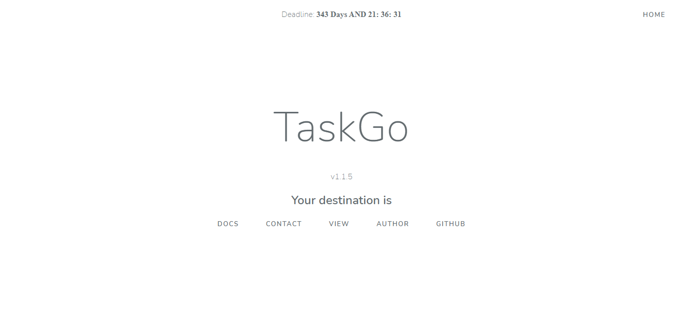
TaskGo
is a solution set out to solve project management problems

Slide 7
2.
Systems Analysis and Design

Slide 8
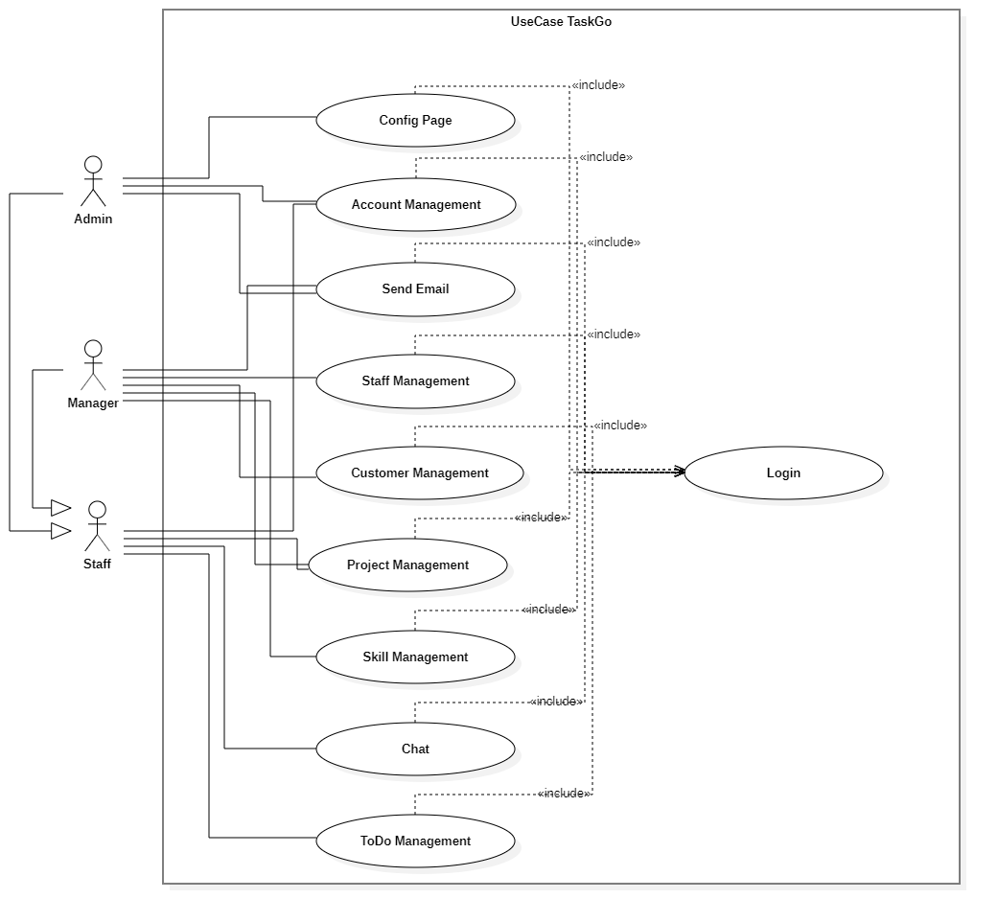
Use-case Diagram

Slide 9
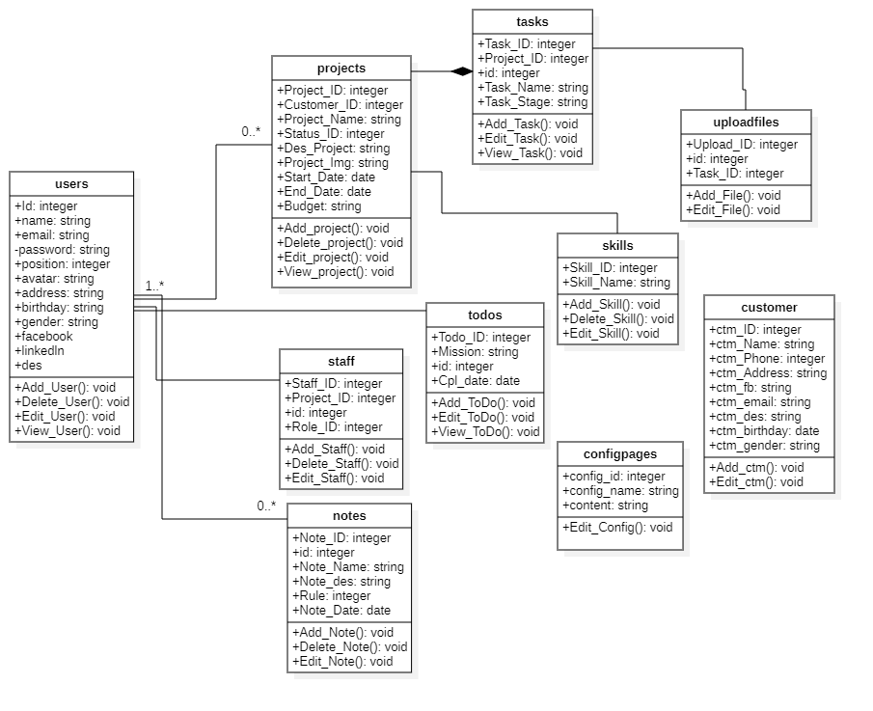
Class Diagram

Slide 10
3.
Website’s interface
The best tools to help you deliver better results - on time and on budget.

Slide 11

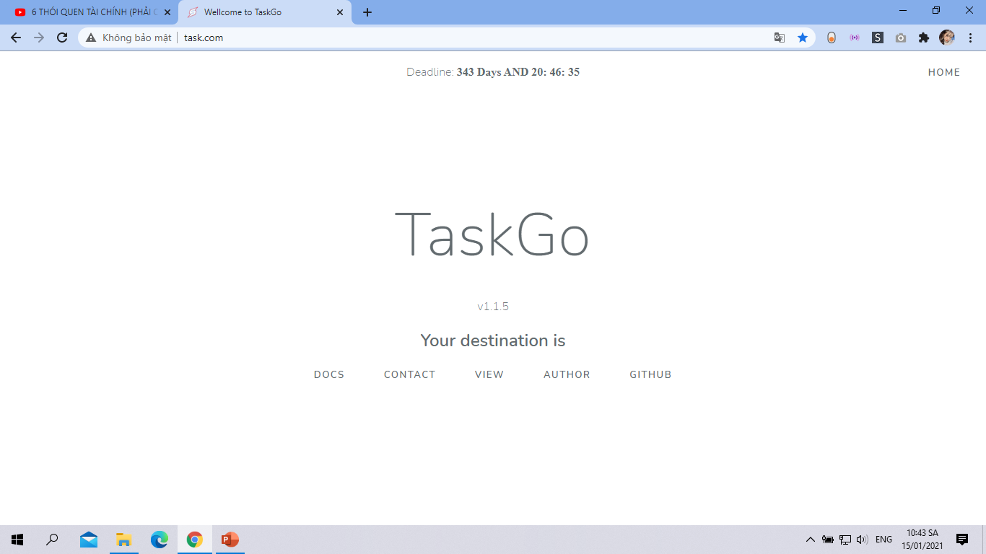

Slide 12
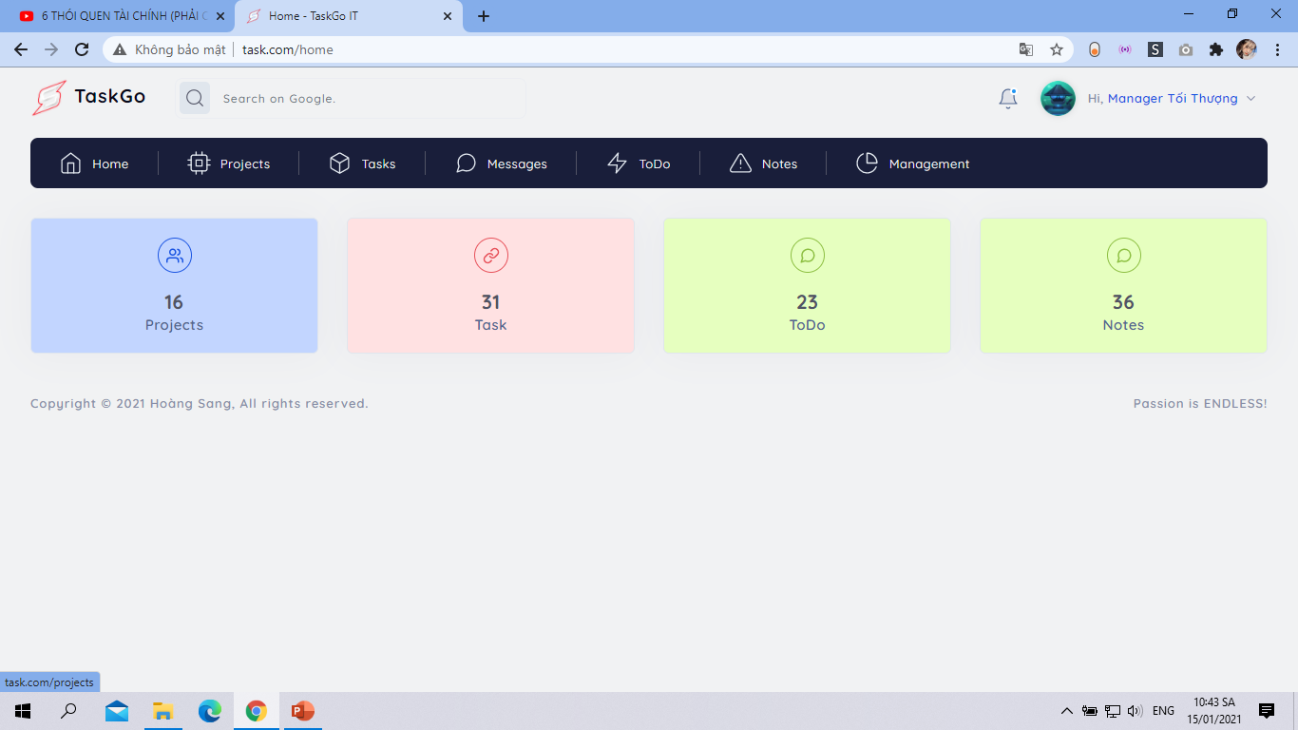

Slide 13
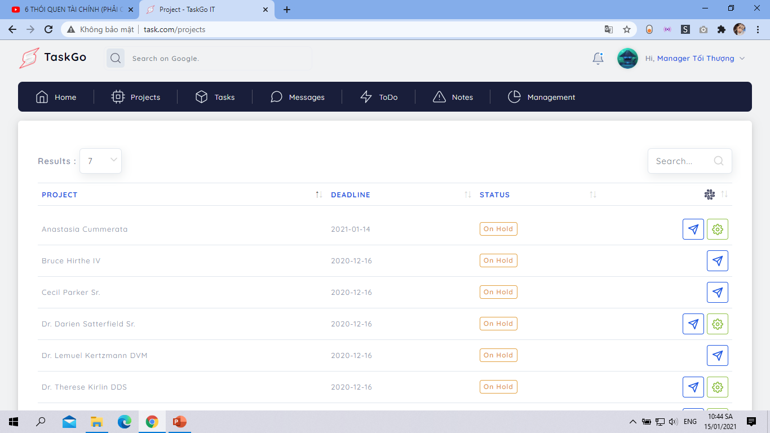

Slide 14
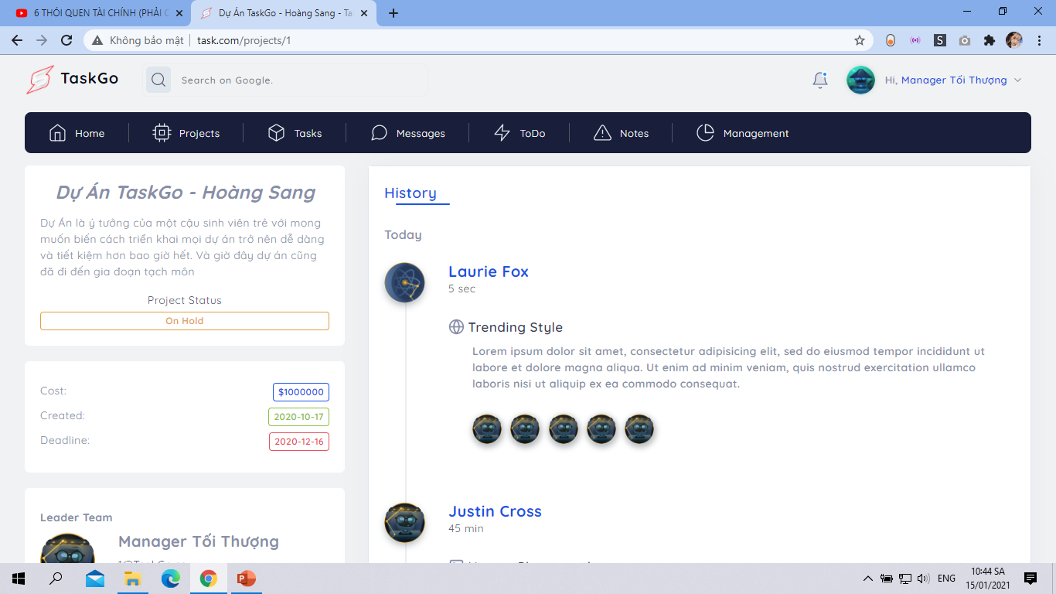

Slide 15
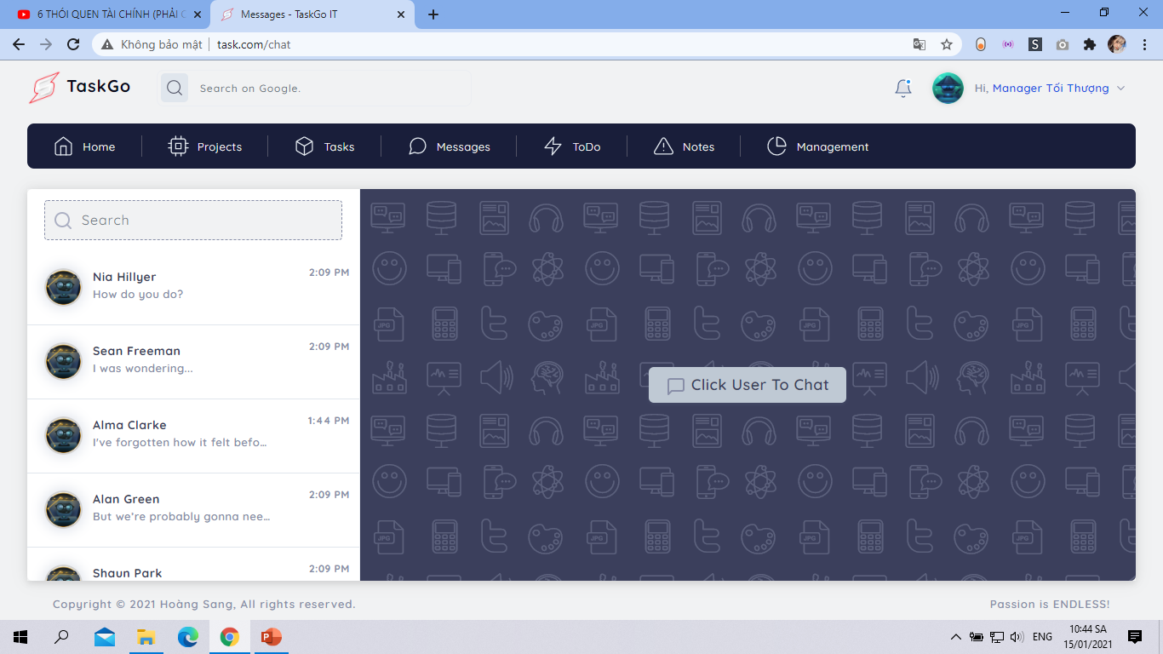

Slide 16
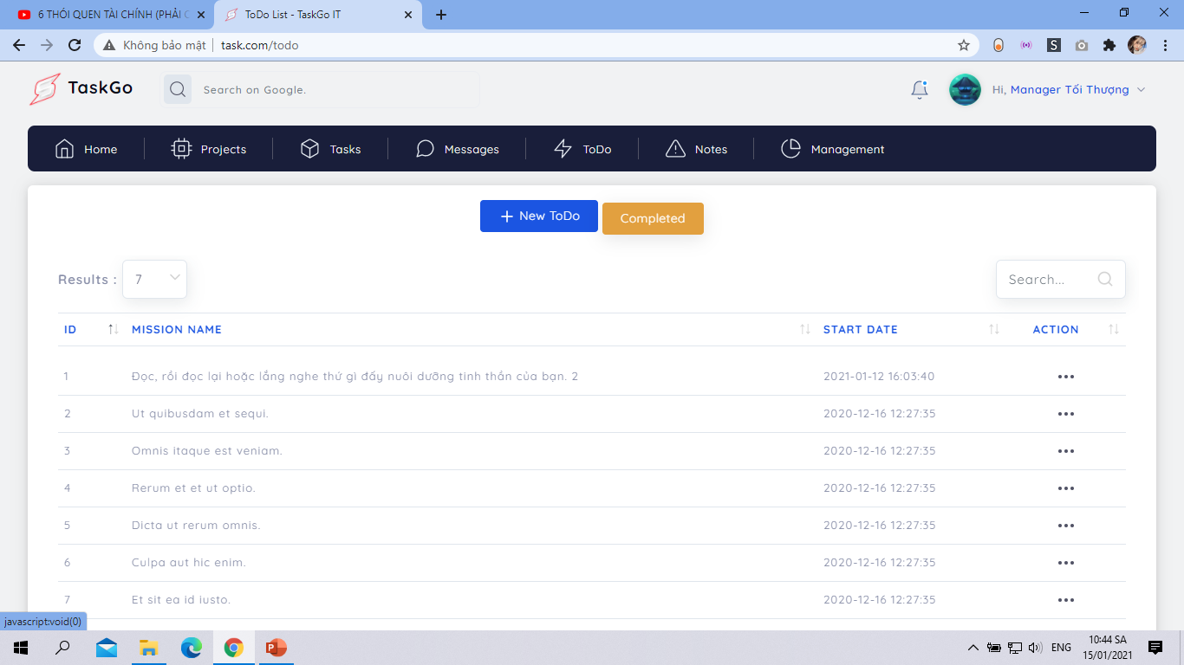

Slide 17
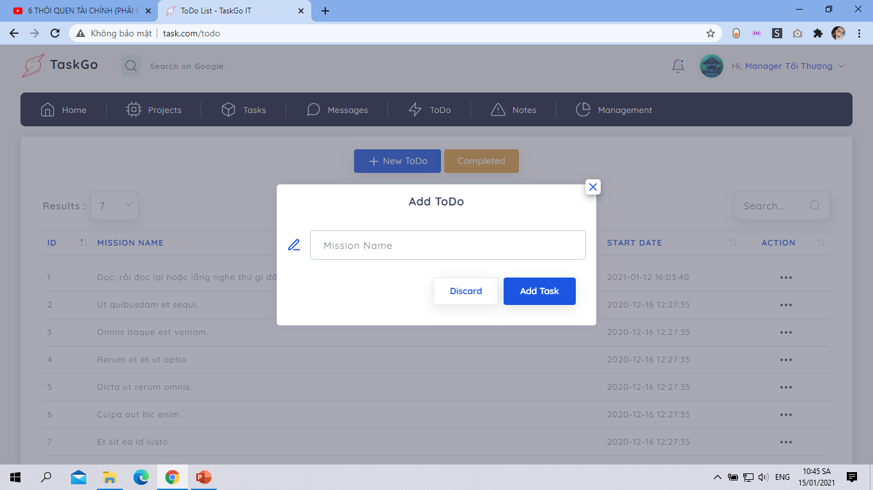

Slide 18
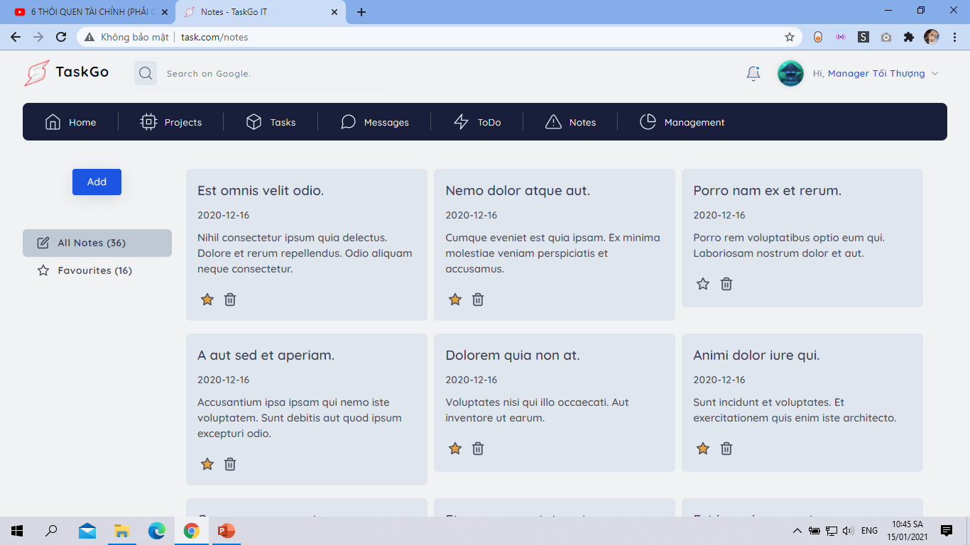

Slide 19
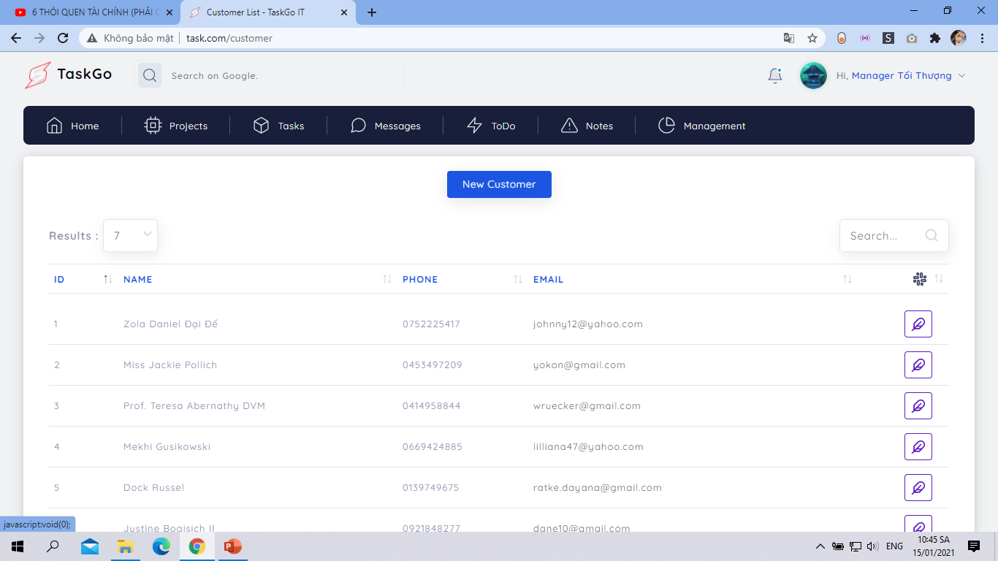

Slide 20
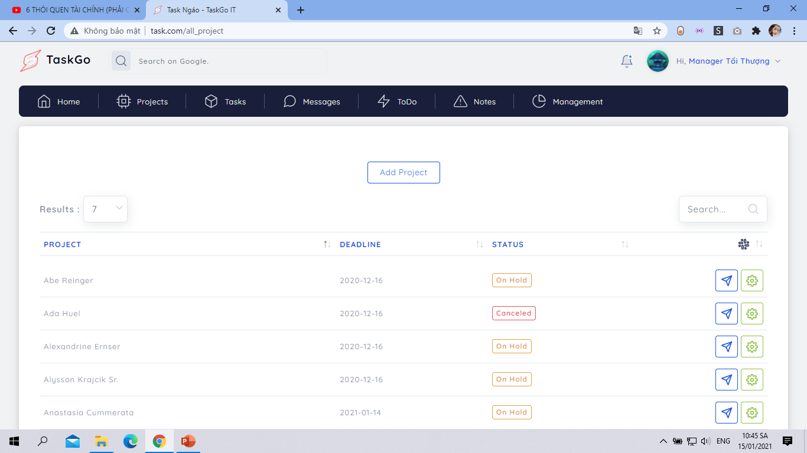

Slide 21
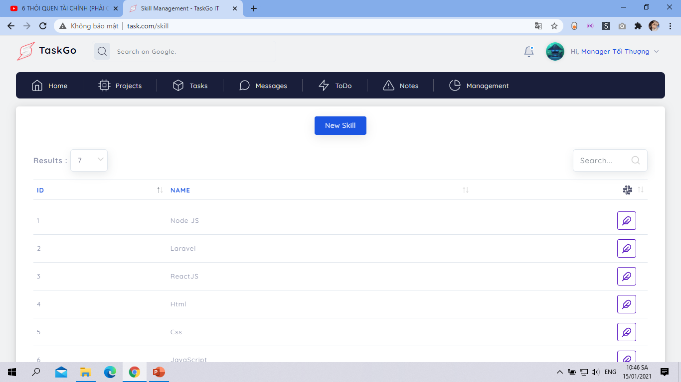

Slide 22
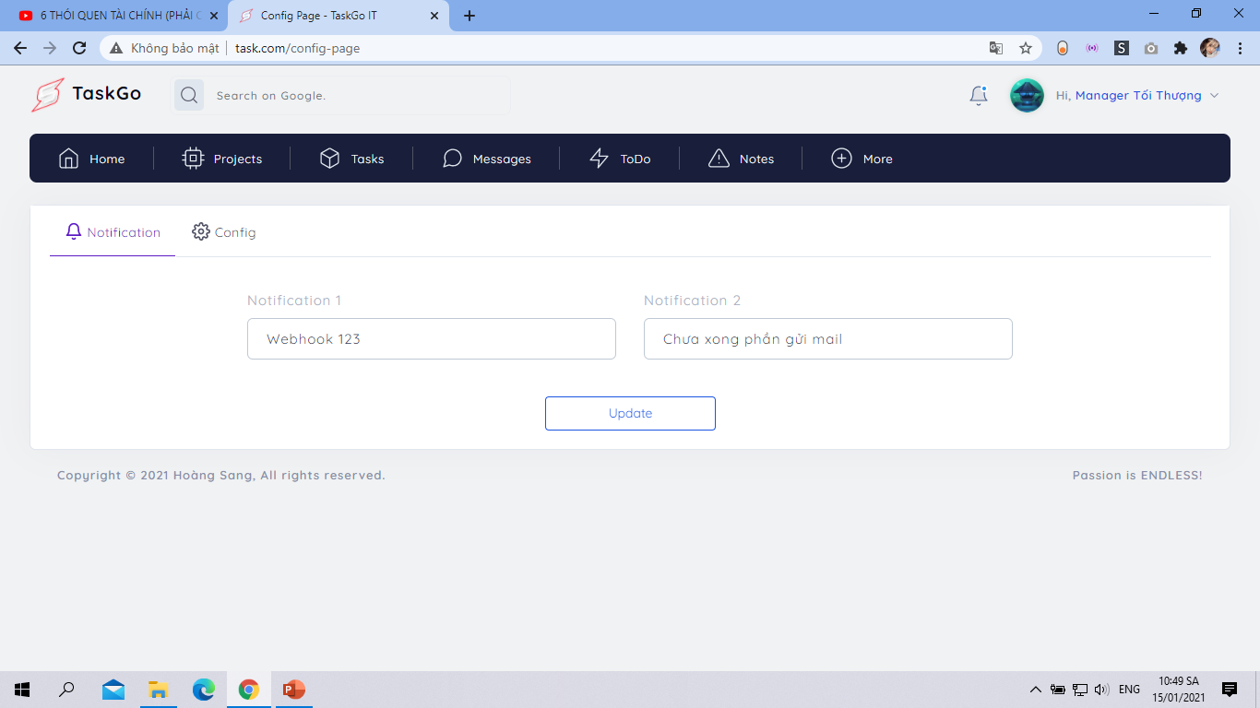

Slide 23
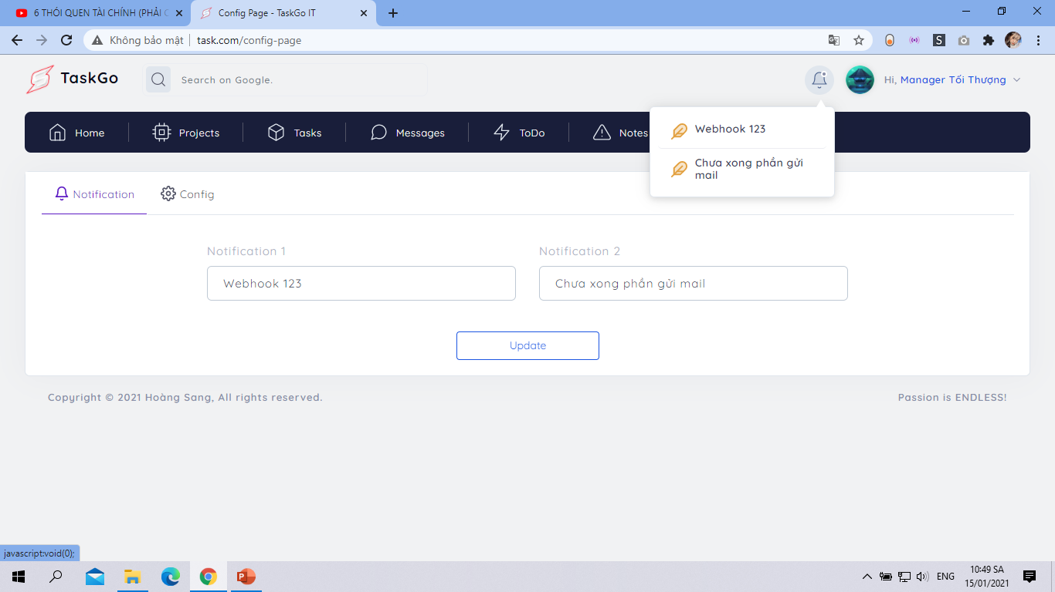

Slide 24
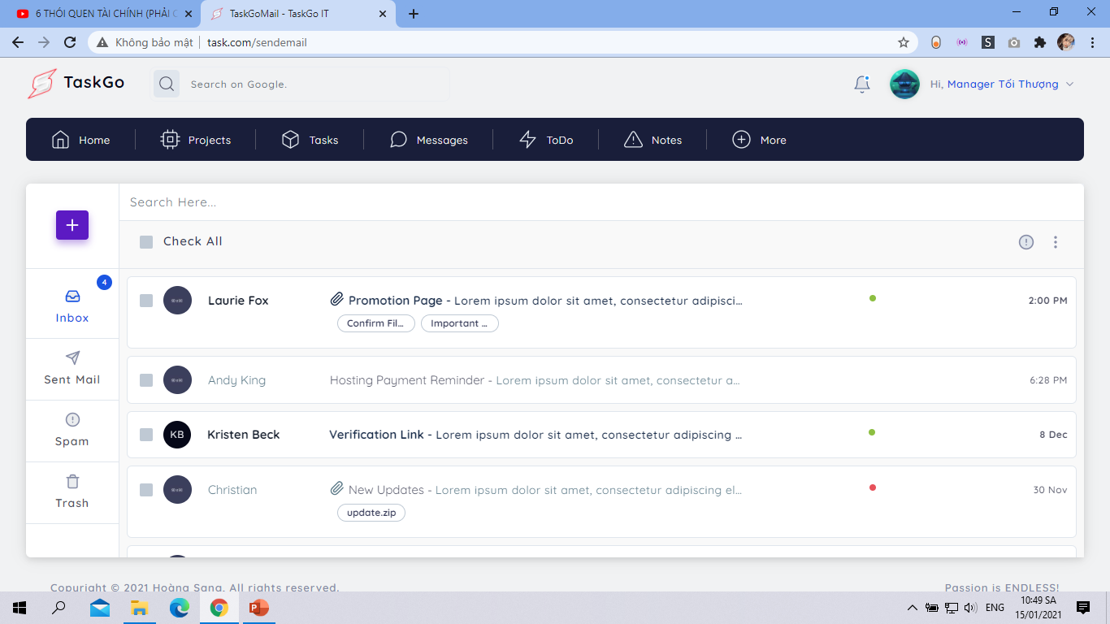

Slide 25
Thanks!
Any questions?

